Slide 1
The Hermit Crab and the Octopus

Slide 2
Hermit Crabs
Small crabs that move from shell to shell as they grow
They are born in the ocean, but live on the shore as adults
https://www.youtube.com/watch?v=0jZe_VGLRYI

Slide 3
Octopus
An octopus has eight tentacles and three hearts
They can change colors and produce ink to escape danger
https://www.youtube.com/watch?v=eLJ-Yy2Mq3c *no sound*
https://www.youtube.com/watch?v=BULXKrzLhig

Slide 4
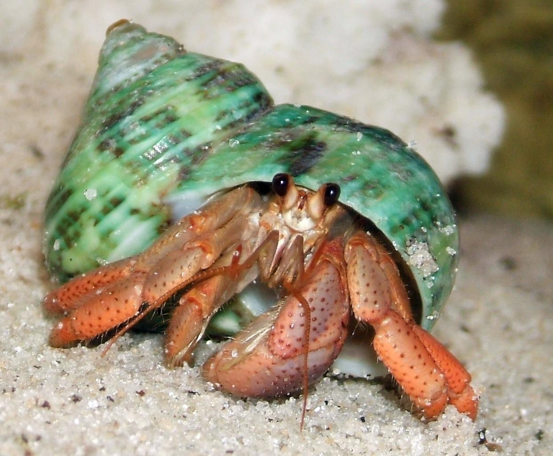

Slide 5
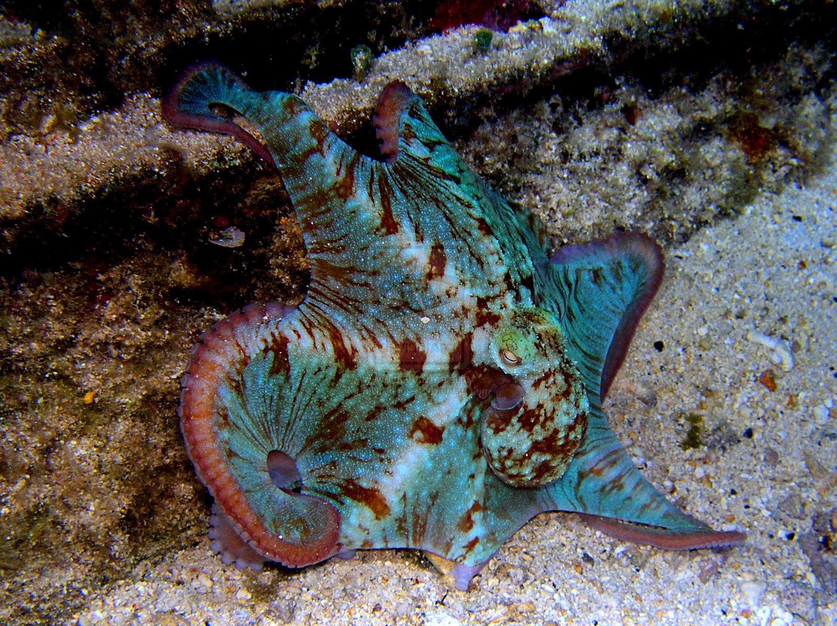
The Caribbean reef octopus lives around coral reefs around the Caribbean islands.

Slide 6
What is the central message of this story?
Who learned a lesson?
How do you know?

